Slide 1
A Data-Driven Approach to Predicting Fatalities in Violent Organized Crimes Across Africa Using Machine Learning Regression Models
Presenters
1. Patrick Anaku
2. Steven Magezi
Presented by – Patrick and Steven
Affiliation: Makerere University
Uganda

Slide 2
Introduction
Crime in Africa is a major socioeconomic problem caused by the uneven distribution of wealth, political power, and labour.
This crime takes on different forms, including but not limited to violent and organized crime and terrorism. On the African continent, distinct regions are subject to diverse forms of crime.

Slide 3
Background
Crime in general have great impact on the livelihoods. In Africa, violent organized crimes have caused widespread social, political and economic damage to the continent, compromising livelihoods and threatening security and stability.
There has been an increasing use of statistical data in many disciplines to guide decision-making. The use of computer models can be on great help in efforts to predict and reduce the impact of such violent organized crimes.
Notes:
The dataset can be found here.

Slide 4

Problem Statement
Analyse
Analyse historical ACLED crime data collected from different African countries.
Identify
Identify patterns, most important factors that lead to fatality.
Develop
Develop a predictive machine learning model for the number of fatalities.

Slide 5
Gaps in Related Research
Most traditional crime analysis tools deal with homicide and gang-related crimes. Moreover, few existing works have stopped at data exploration. However, in the African context, more research is needed overall.

Slide 6
Significance of the Project
Aid in Public Safety and Crime Prevention.
Decision Support system for Stake holders.
Add to the knowledge base of violent crime analysis using machine learning methods.

Slide 7

Research Questions
Relationship between actors of crime and criminal activity.
What are the patterns of specific types of crime.

Slide 8
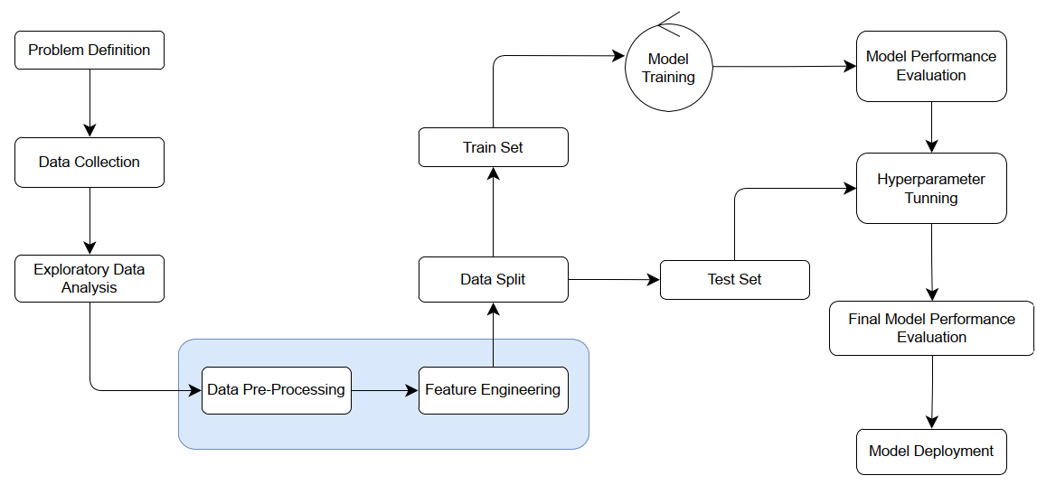
Methodology

Slide 9
The Dataset
Key features
1. Dates and precise locations of conflict events.
2. Categorization of event types such as battles, civilian killings, riots, protests, and recruitment activities.
3. Event actors involved, such as rebels, governments, militias, armed groups, protesters, and civilians.
4. Documentation of reported fatalities.
Description
Armed Conflict Location and Event Data Project (ACLED) dataset for African Continent. The records date back to 1997 to date, with a weekly update.
And encompasses a broad spectrum of events, such as civil wars, public protests, and regime breakdowns.
The raw data has a shape of (389425, 31) consisting of some null values in some variables.

Slide 10
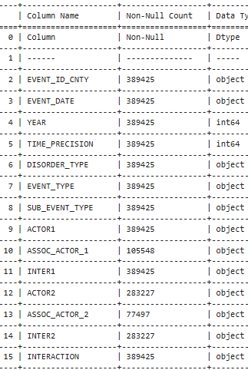
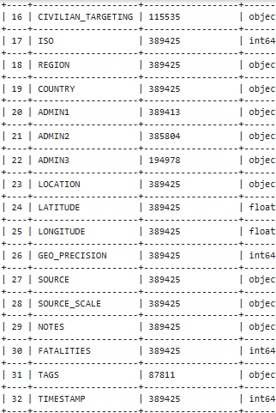
Dataset continued
That raw data has a shape of (389425, 31) with some missing values

Slide 11
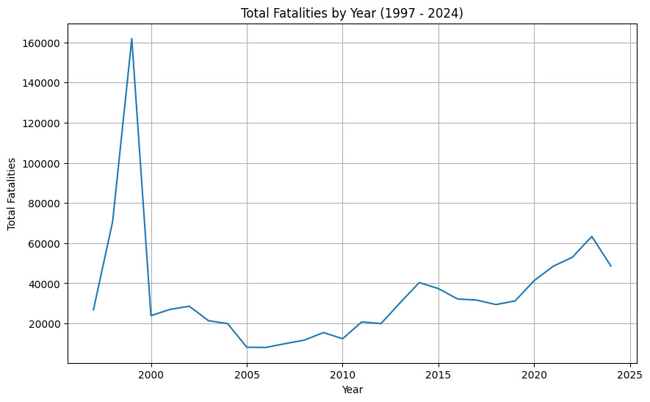
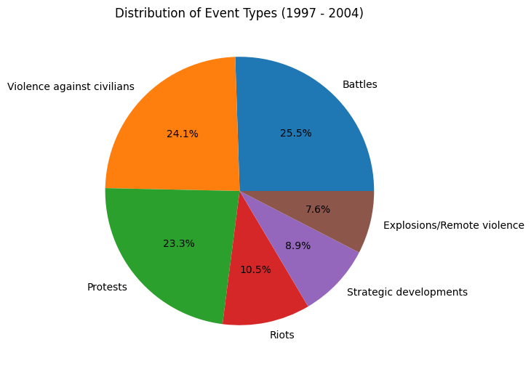
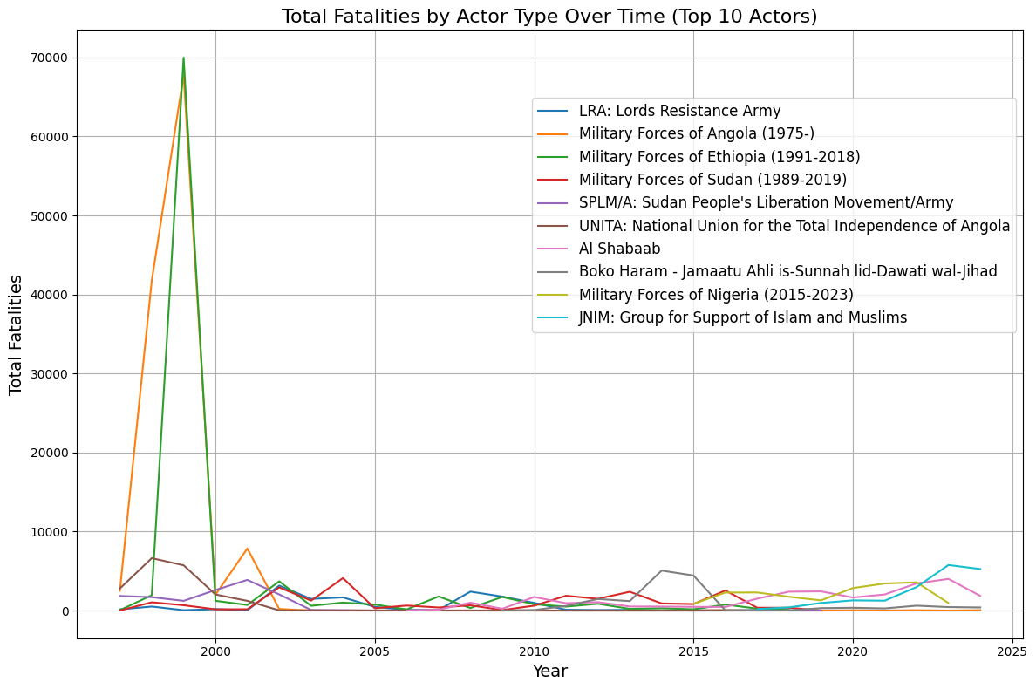
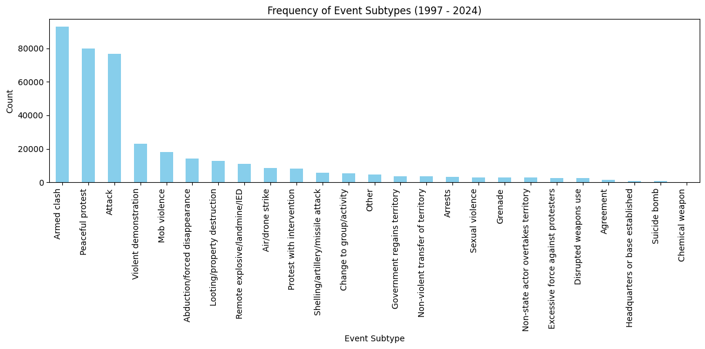
EXPLORATORY DATA ANALYSIS’
Examine relationships between features and target variables

Slide 12
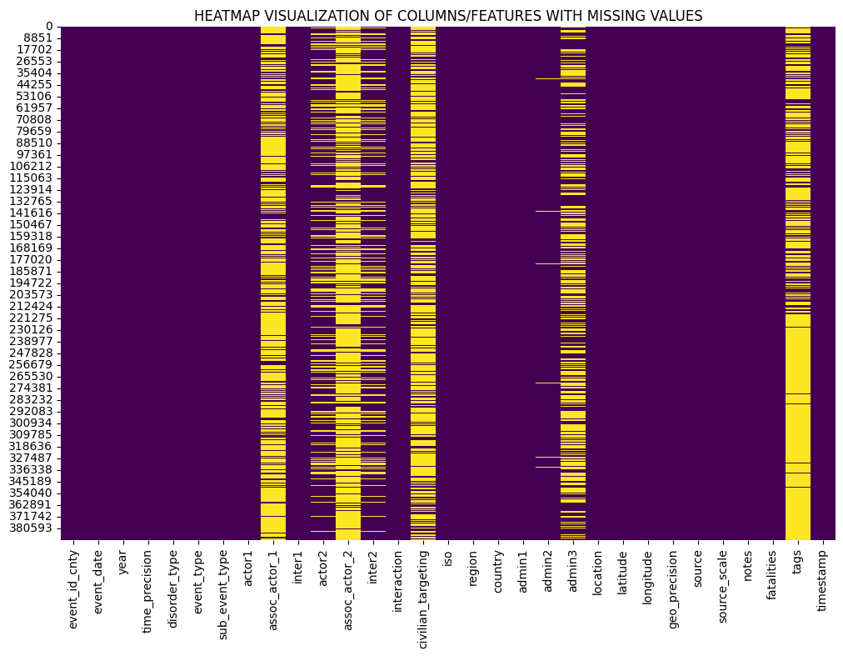
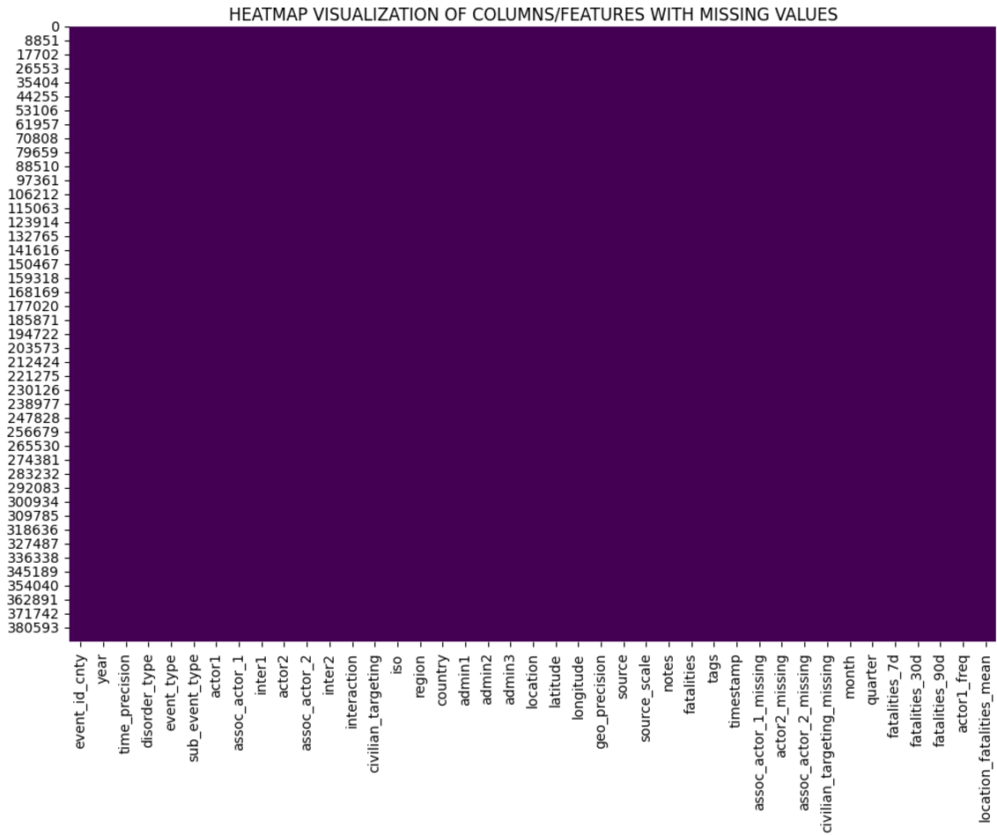
Data Pre-Processing & Feature Engineering
Mode Imputation, TargetEncoding, StandardScaler and Feature Interactions
Columns with significant missing values: (assoc_actor_1, actor2, assoc_actor_2, civilian_targeting, admin3, and tags)
Columns with few missing Values ((admin1, admin2 and inter2)

Slide 13
TRAININED MODELS
Linear Regression
Lasso Regression
Random Forest
Support Vector Machine (SVR)
Bayesian Ridge Regression
Gradient Boosting Regression
XGboost regression
The seven listed models were trained on the dataset using similar ML Pipeline. The performance of each evaluated again common metrics.
Notes:
Link: https://sorry.vse.cz/~berka/challenge/PAST/

Slide 14
Performance metrics used to select best model
Adjusted R-squared: Accounts for number of predictors. Smaller differences imply relevance of predictors.
Median Absolute Error: Lower suggests close predictions.
Explained Variance: Measures proportion of variance in the target variable. Higher is good
MSE: Lower generally indicates a better fit
RMSE: It is similar to MSE lower means better performance
MAE: Smaller figure indicates better model accuracy
R-Squared: Measures the variance in the target variable from 0 to 1, where values closer to 1 indicate a better fit

Slide 15
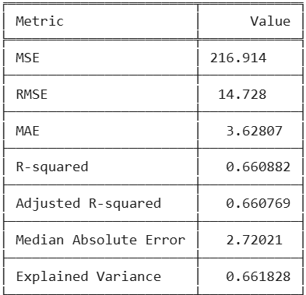
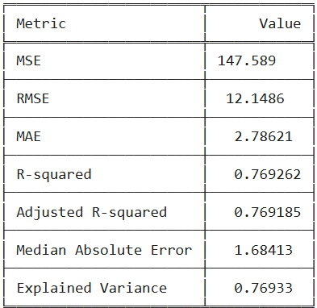
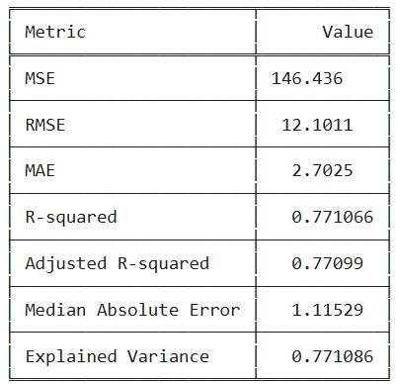
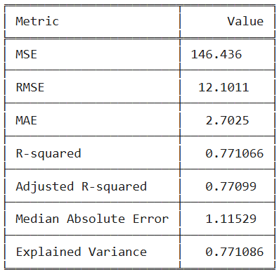
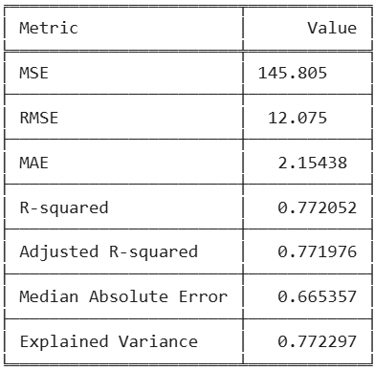
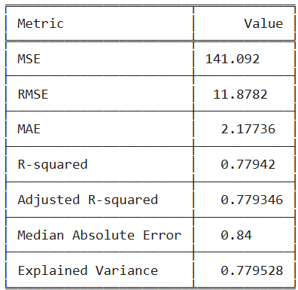
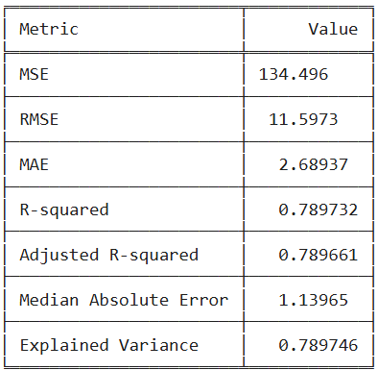
Model Performance
SVR
Gradient Boosting
Lasso Regressor
Linear Regressor
XGBoost Regressor
Random Forest
Ridge Regressor
Notes:
Link: https://www.kaggle.com/datasets/santoshd3/bank-customers

Slide 16
Selected Model
Ridge Regressor selected for further development, based on the metrics measured

Slide 17
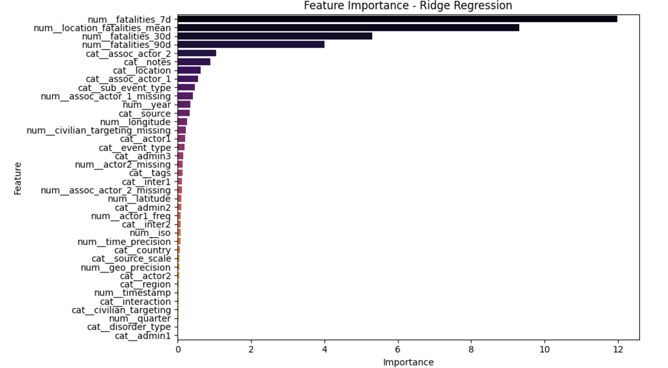
Feature Importance – Traditional approach

Slide 18
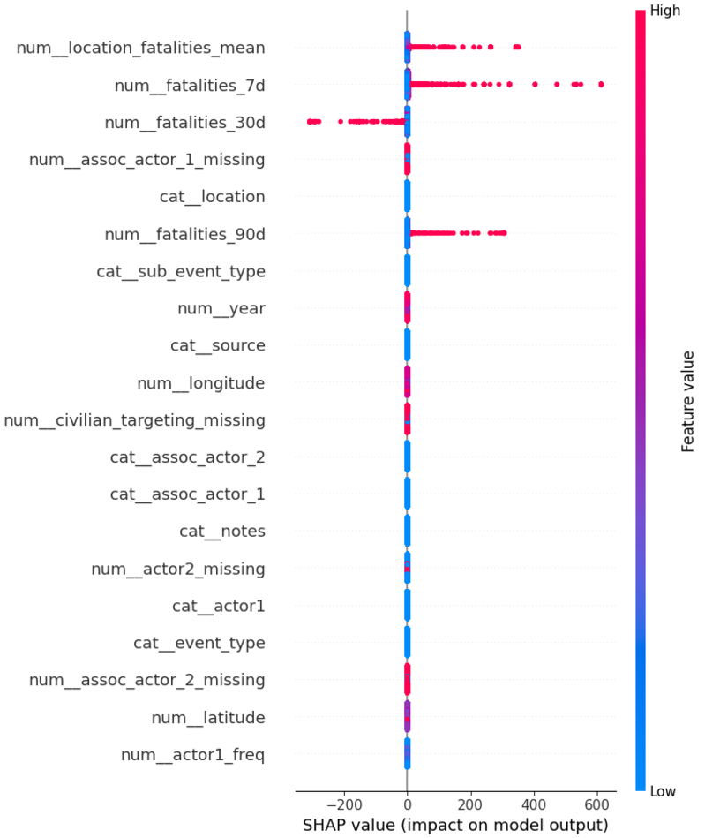
Explainability of Model
SUMMERY PLOT OF SHAP VALUES

Slide 19
Conclusion and Future works
This study aimed to analyze conflict events in Africa using the ACLED dataset and machine learning models to identify patterns, and understand the factors driving conflict and use the insights learned to predict fatalities,
As part of our future work, we intend to incorporate other factors such as; socioeconomic indicators, to help our understanding of conflict dynamics. Furthermore, we will look out for data on conflict resolution efforts and their outcomes which we believe can enhance our analysis and provide additional insights.

